Slide 1
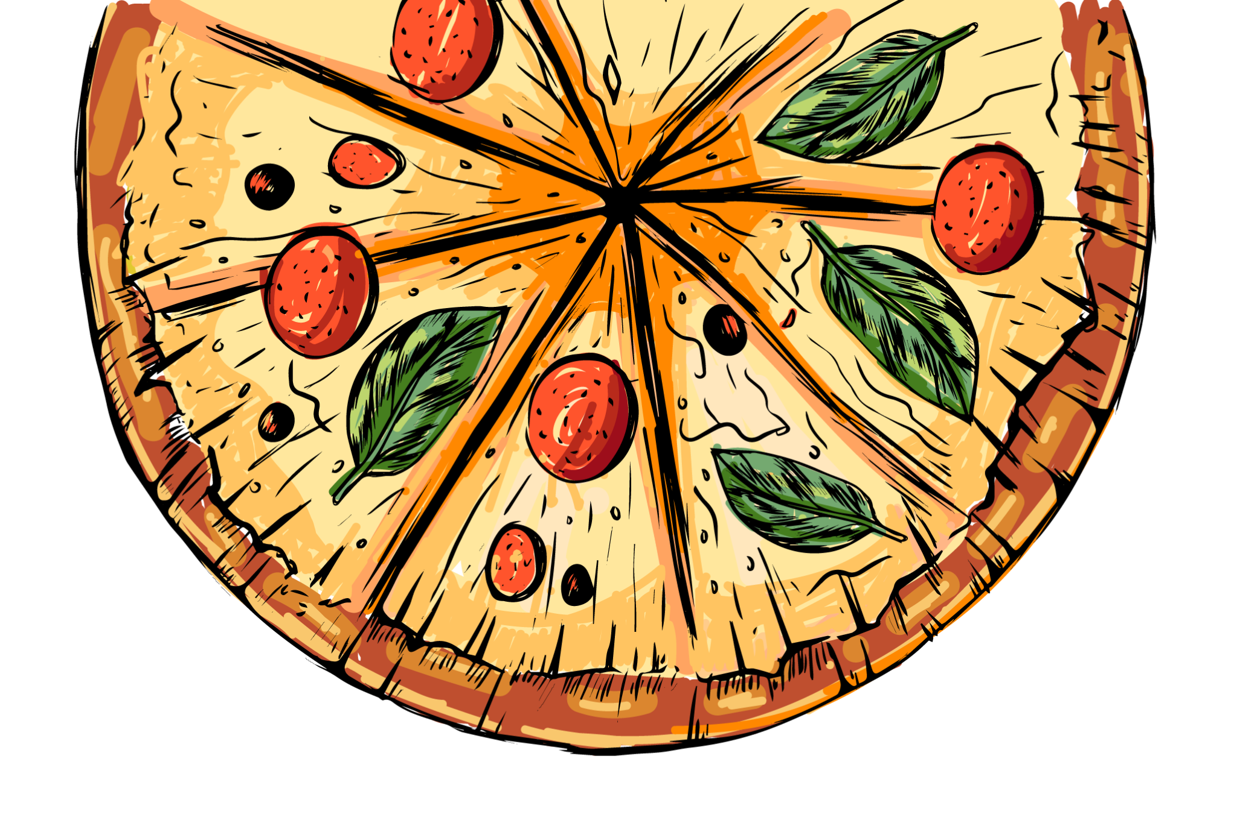
PIZZA Sales
www.slidesgo.es
Analysis
BY: Sushmita Rawat

Slide 2


TABLE OF CONTENTS
01
02
03
04
Introduction
Goal & KPI
We will discuss about the problem and the background
The goal and key performance indicator used
Recommended Analysis
Conclusion
Key business question and insights
Conclusion of the report

Slide 3
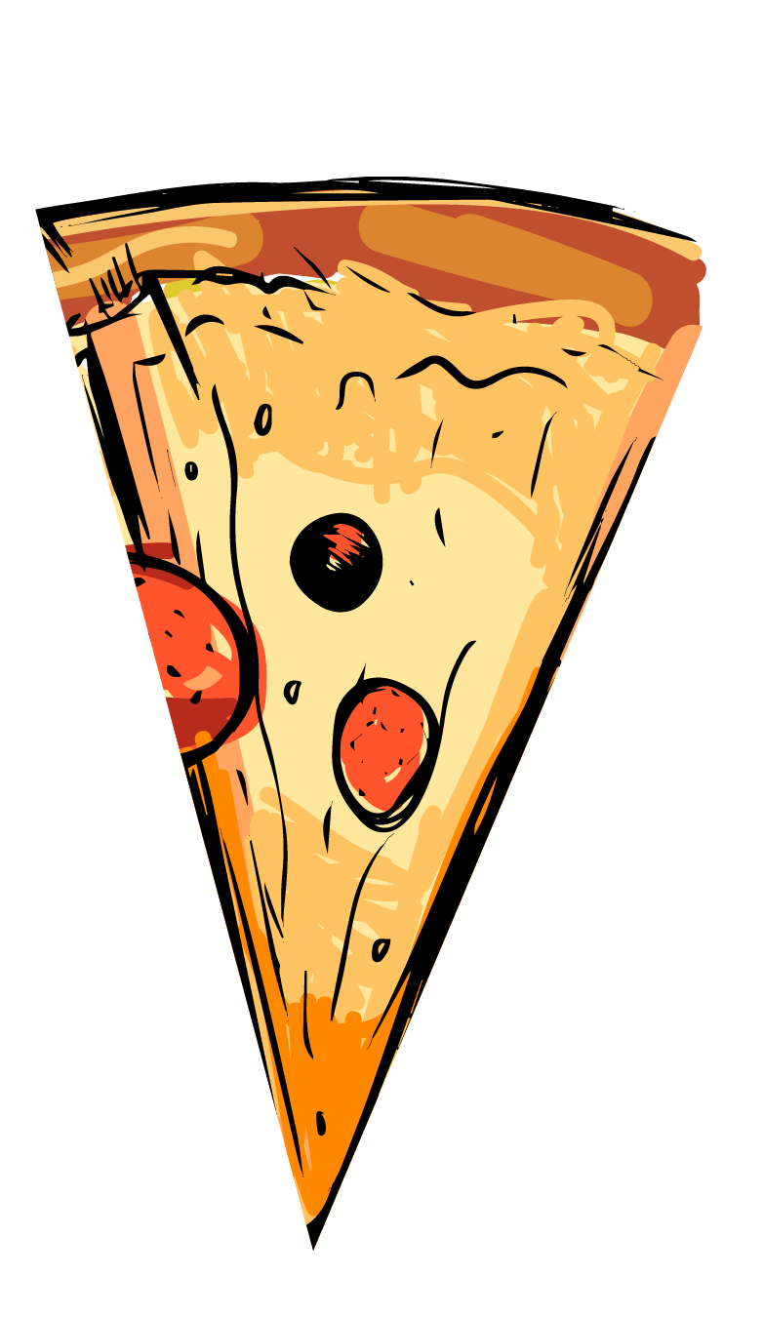

INTRODUCTION
Problem
The pizza restaurant is experiencing a sales slump and aims to boost revenue by analyzing customer and order data. To achieve this, the management will conduct an in-depth examination of order trends and consumer behavior to identify key patterns, preferences, and areas for improvement. This data-driven approach will inform strategic decisions to drive sales growth and enhance customer satisfaction.

Slide 4

An overview of pizza sales data from January 2015 to December 2015, aggregating insights from pizza joints across the United States to uncover trends and patterns in pizza sales.
Background

Slide 5
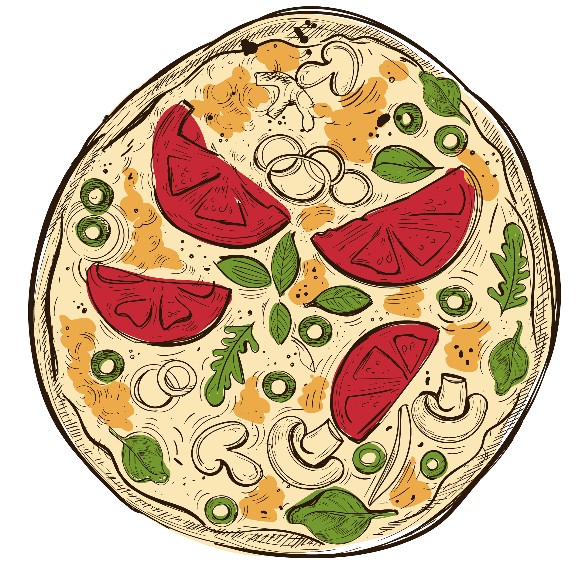

02
The Goals &
KPI’s
The goals and KPI’s used in the analysis report.

Slide 6
Goal & KPI’s
The Goal
KPI’s
Boost pizza sales by 10% within 6 months.
Identify and resolve the underlying causes of declining sales.
Enhance customer satisfaction and loyalty.
Develop a deeper understanding of customer behavior and preferences.
Total pizza sales revenue
Number of pizzas sold
Average order value

Slide 7
03
Recommended
Analysis
Key business question and insights

Slide 8
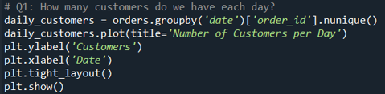
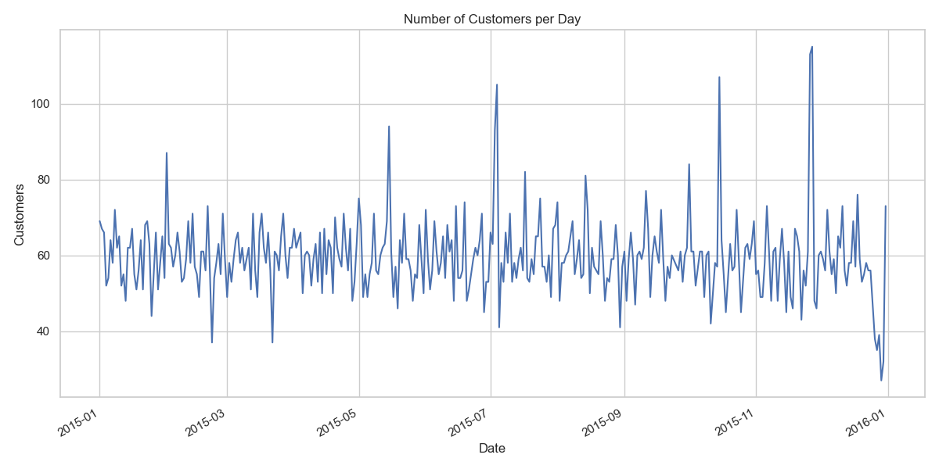

Q1. How many customers do we have each day? Are there any peak hours.
Our pizza outlet sees an average of 60 customers per day, with peak hours between 12-2 pm and 6-8 pm.

Slide 9
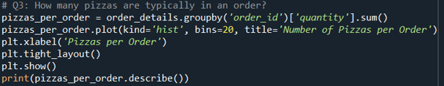
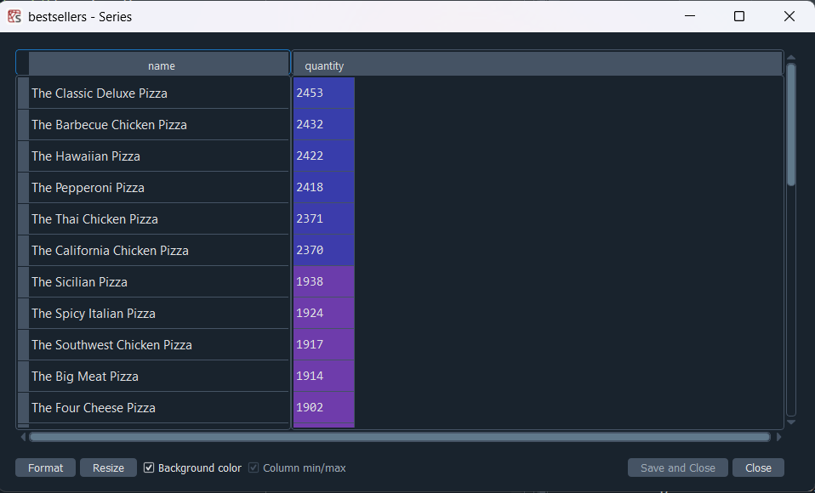
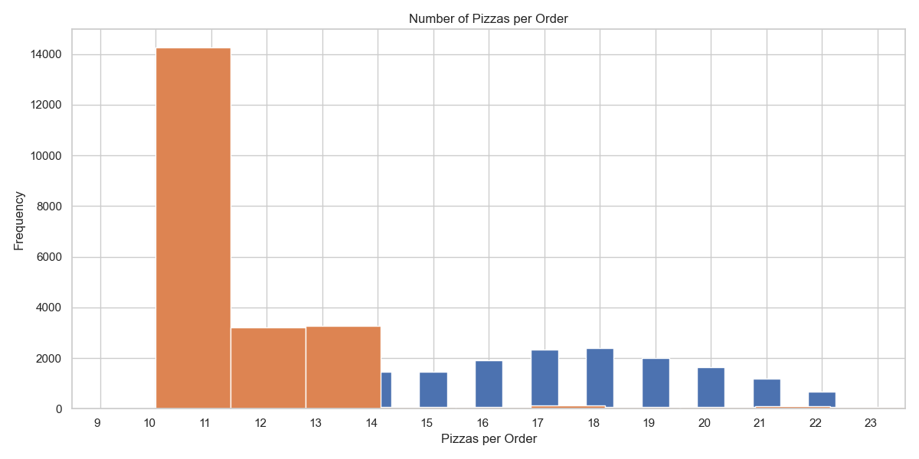
Q2. How many pizzas are typically in order? Do we have any bestsellers?
Customers typically order 2-3 pizzas per transaction, with our top-selling pizza being the Classic Deluxe Pizza.

Slide 10
817,860
How much did we make this year?

Slide 11

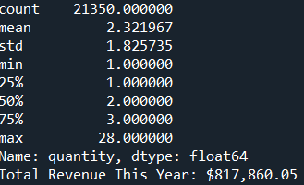
Q3. How much money did we make this year? Can we identify any seasonality in the sales?
This year we made $ 817,860.05 & Summer & December is the highest selling season

Slide 12
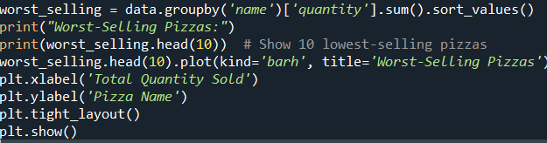
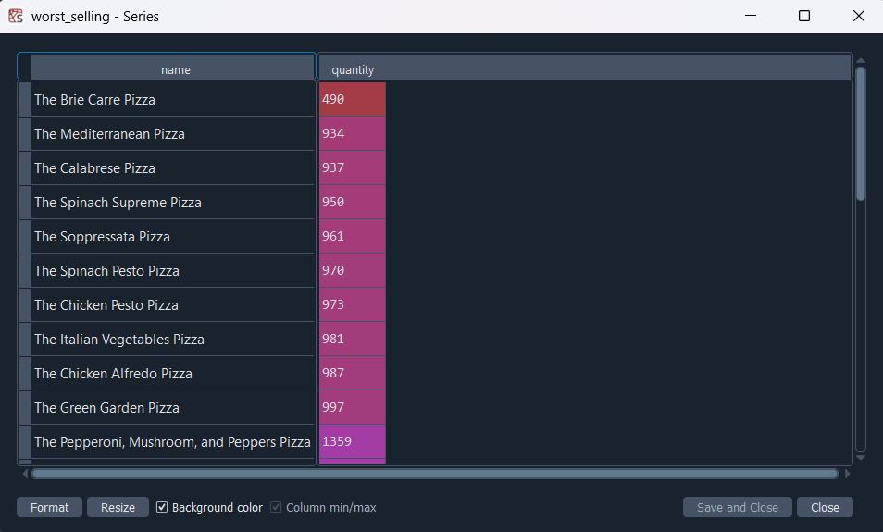
Q4. Are there any pizzas we should take off the menu, or any promotions we could leverage.
We can consider removing Brie Carre Pizza from our menu due to its low order volume. Additionally, given that summer is our peak season and fall is our slowest, we can introduce seasonal discounts or promotions to drive sales during off-peak periods.

Slide 13
04
Conclusion
Conclusion of the report

Slide 14
Conclusion
The dataset provides a comprehensive overview of pizza sales and ordering trends over a year. It can be analyzed using tools like Excel to gain valuable insights and make informed decisions about sales patterns, customer preferences, and business strategies

Slide 15
THANKS!
Do you have any questions?
sushmitarawat456@gmail.com
https://www.linkedin.com/in/sushmita-rawat-143a46217/

